Slide 1


Business Financing Explained According to Lessons from Everyday Life*

Slide 2
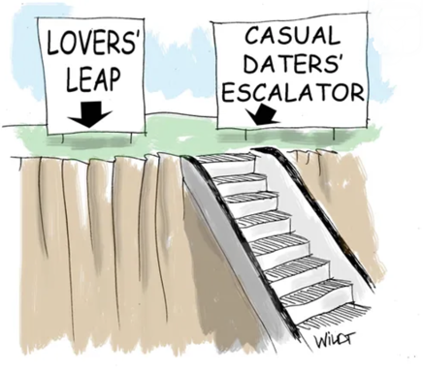
Observation: We All Know No Human Relationship Is Without Risk….
Yet very few people choose to go through life all alone
It’s the same with business financing…

Slide 3



What Are the Different Business Financing Options?
Most like marriage somewhere where divorce is almost impossible
Most like dating multiple people at once
Most like on again, off again dating
Debt
Equity
Reseller relationships
Any combination of these

Slide 4


Business Financing & Romantic Relationships Have a Lot in Common
For a lasting relationship, there needs to be “chemistry” – or at least genuine belief, and ultimately a shared set of values
But even for quick, no-future-obligation transactions, there must be enough attraction / motivation on both sides for it to go anywhere

Slide 5

Being Alone Is Okay… Until It Really Isn’t

Slide 6

At the Same Time…
If you don’t take selecting financing partners seriously, you can make a huge mistake

Slide 7

The Past Often Gives a Clue as to Future Behavior…

Slide 8

Why Understanding Business Finance Matters
Because No One Has a Crystal Ball
Even in peacetime, a small but growing company is going to face situations it just did not foresee
Some of these situations can pose existential risk to the company

Slide 9

Why Understanding Business Finance Matters
Because No One Has a Crystal Ball
Or can be unexpected, but great opportunities to accelerate your business
Whether risks or opportunities, such situations often cost money in the short run!

Slide 10

Why Understanding Business Finance Matters Because Managing Gaps Can Be Harder Than It Looks
CEOs without finance backgrounds often underestimate the difficulty of managing cashflow as the business grows
    Customers may not always pay on time, but expenses like payroll, rent, etc. happen on fixed dates
    Sometimes significant delay in doing something important is more costly to your business than the capital would be

Slide 11
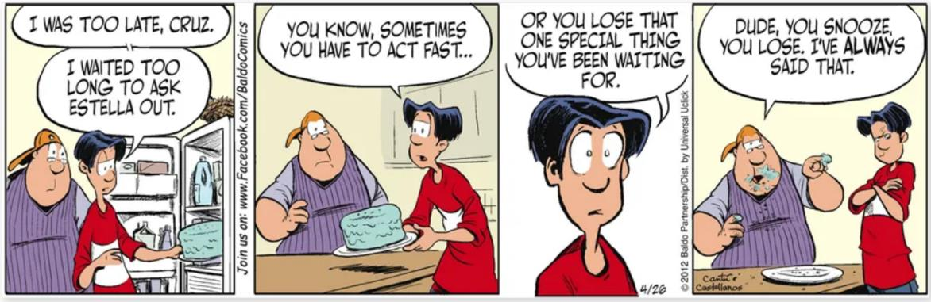
Why Understanding Business Finance Matters Because Managing Gaps Can Be Harder Than It Looks
  If you are too slowed down and/or focused on your cash position, you may lose out to a competitor who is not so slowed
Even if inside Ukraine, during the war everyone will cut you a break, this is NOT
true once dealing with entities outside of Ukraine who have their own financiers
to keep happy!

Slide 12




Business Financing Is a Very Normal Part of Running a Business in the West
All growing companies, whether start-ups or large corporations, routinely seek more capital. Reasons include:
  Limited or inconsistent cash flow for whatever the reason (e.g. world events, seasonality, etc)
  Ease short term cashflow problems due to unforeseen expenditures/expenses that require a large, and often near-term payment, (e.g. sudden equipment / plant failure which requires immediate replacement.)
  To expand the company in some way, (e.g. new office, new equipment, new employees, etc)
  If they believe that securing capital may become much more difficult in future

Slide 13



What Are the Available Options?
Debt Financing
  Loans
    Secured
    Unsecured
  Lines of credit
    Receivables factoring
  Friends & Family / informal
  With warrants
Equity Financing
  From individuals
  From funds
  Friends & Family / informal
Prepayments (Resellers)
  Royalties
  Other prepayments
Any combination of these

Slide 14


Debt Financing

Slide 15
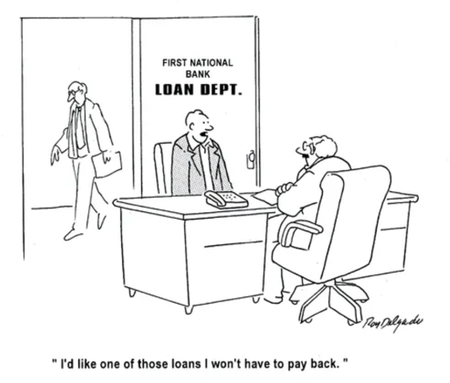
Debt Financing - Introduction
Simplest example is a credit card
  It’s a normal part of daily life, though technically you are borrowing money when you use it
  You could change your credit card provider every week if you wanted
Money borrowed must eventually be repaid
  Short of bankruptcy or renegotiation (which should never be assumed)
  More and more interest will accrue until the money is repaid

Slide 16
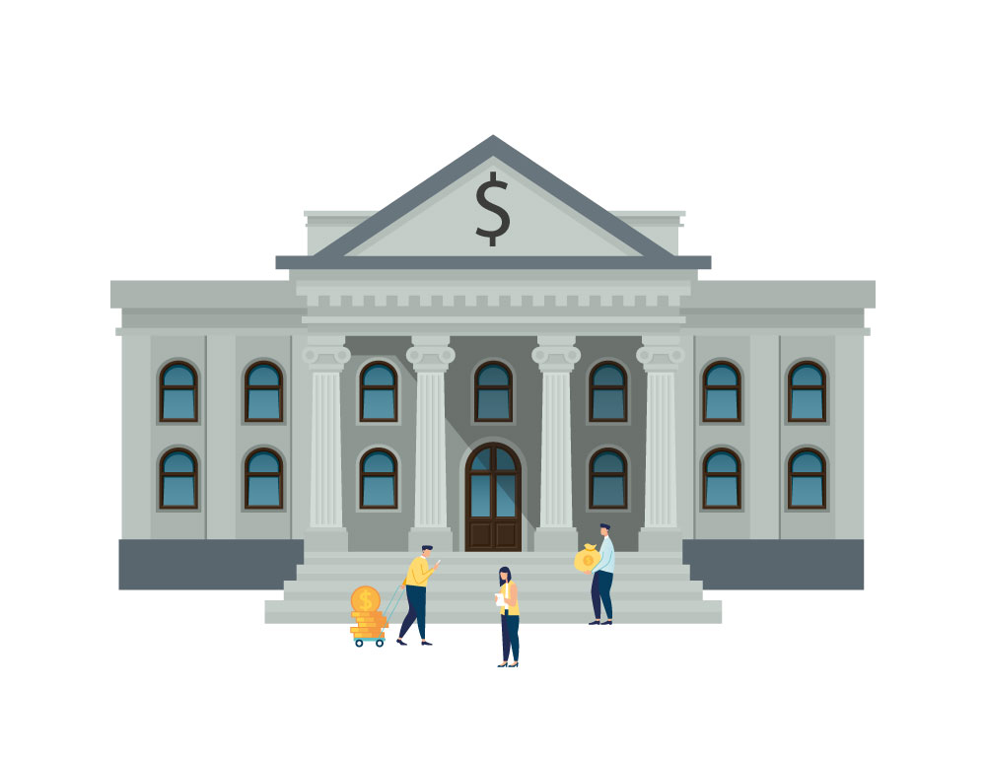
Debt Financing – Who Does It?
Debt financing comes mostly from large financial institutions, not (relatively) smaller investors. This is because one needs to do a large amount of lending to make significant money
  The financial upside to the lender is limited with most kinds of loans; both laws and practicality limit the amount of interest they can get.
  Some % of the time, the loan money is just lost
NOTE: In the West, interest rates are a fraction of what they are in Ukraine

Slide 17
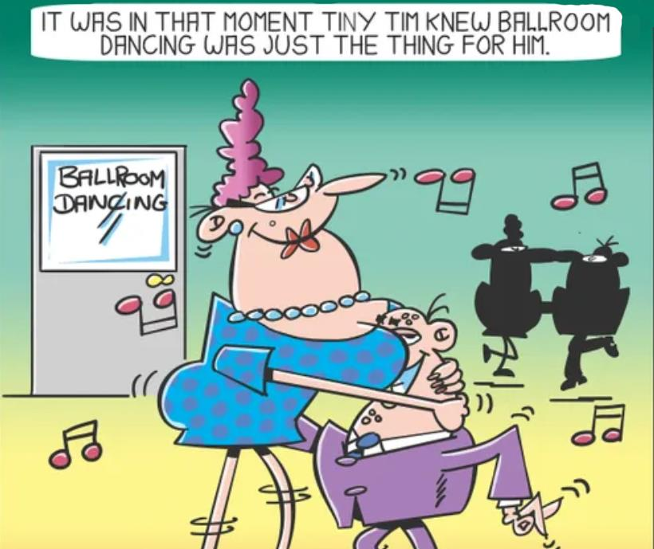
Debt Financing – Who Does It?
However, there are some important, relevant exceptions to this
  Some investment funds can choose to do loans as a way to build the relationship
  And/or to obtain stock

Slide 18

Business Loans
Usually for a specific business purpose, such as purchasing specific equipment or some type of expansion of the business.
  The loan must be used for the stated purpose(s)

Slide 19
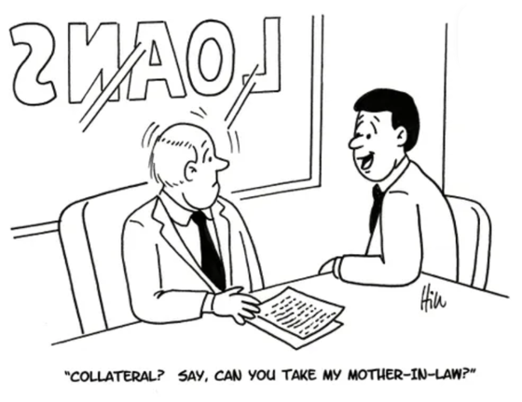
Business Loans Cont’d
Almost all loans are secured
This means that lenders will require some kind of collateral This is an asset that backs the loan. Examples include:
  Physical things, like property,
  valuable equipment, or a factory
  Patents
  The company itself, if it has contracts of value that are transferable

Slide 20
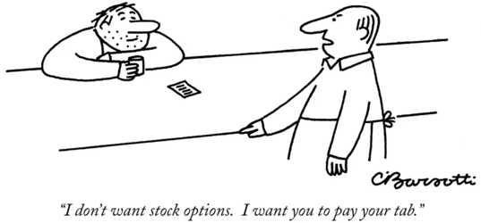
Other Types of Debt Financing – Warrants & Stock
Warrants are the equivalent of stock options for entities rather than individuals
  Or can also just be outright shares too
Under what circumstances and at what price they can be exercised (acquired) is part of the contract

Slide 21

Other Types of Debt Financing
Lenders can ask for other things besides interest
  In fact they can ask for anything that is agreed upon with the borrower and is not illegal
  Example: An investor in an art studio could demand some number of paintings by a given artist

Slide 22
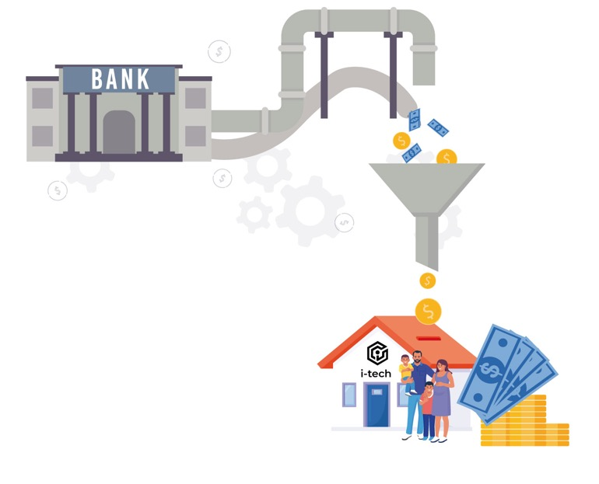
Lines of Credit
A line of credit (LoC) is like a loan, but it is ongoing and can be used for any purpose that the company wishes.
  It is basically a maximum amount that the company can borrow.
Receivables factoring is a common type of LoC in which one borrows against issued invoices

Slide 23

Debt Financing - Pros
Often relatively impersonal: No emotional or ego commitment
Lender has no involvement in the running of your business
Obligation to the lender ends upon full repayment of loan plus all outstanding interest (and anything else promised in the loan agreement)
  Unless as a result of the loan agreement, the lender also becomes a shareholder
  However, lender arrangements that are pleasing for both parties are often repeated

Slide 24

Debt Financing - Pros
Often a relatively easier & faster access to capital if you have a reliable revenue stream
  Decisions often based on surface criteria
  Lender doesn’t need to understand as much about your business as for an equity investment
  Lender does not need to believe in vast future potential of your company to do a loan

Slide 25
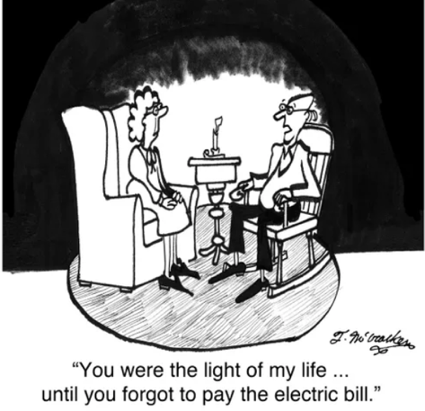
Debt Financing – What Can Go Wrong?
Company must repay the loan, with interest, and satisfy any other conditions of the loan – or default. Default can be catastrophic
  Means that you can lose the asset serving as the collateral
  Or be pushed into bankruptcy
The level of risk greatly influences the interest rate and other terms
  More risk, higher interest
Even if inside Ukraine, during the war everyone will cut you a break,
this is NOT true once dealing with entities outside of Ukraine who have
their own financiers to keep happy!

Slide 26
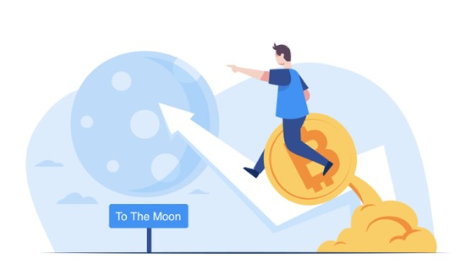
What Do Lenders Want?
Repayment without drama
The ability to lend you ever greater amounts
In some cases, the ability to acquire shares
They want you to grow, and be around for the long haul, so they can keep making money from you
How they make money:
  Interest
  Fees of various kinds
  Profit from shares (if they get them)

Slide 27
Equity Financing

Slide 28

Equity Financing - Introduction
Equity financing involves raising money through sale of shares of your business
  No borrowing, so no repayments
  Investor makes money only when you sell the company (or go public*)
Usually involves sharing the control of your company with an investor
Exact terms are negotiated and depend on the specific circumstances
An equity investment is for the life of the company; it’s like marriage without the practical possibility of divorce
Notes:
* = In most cases, it is very difficult for a military technology company to go public; these days it is much harder for anyone than was the case 20 years ago

Slide 29

Equity Financing – Who Does It?
People and entities who are chasing the big upside
  And don’t mind falling down most of the time in the process

Slide 30

Equity Financing - Pros
With the right investor(s), equity financing can deliver more than just money; you may also benefit from connections, resources, guidance, skills and experience of the investors who have a stake in your business.
May make your company appear more stable to potential customers and other outsiders

Slide 31

Equity Financing – What Can Go Wrong?
Incompatibility/persistent disagreements
  Foreseeable or otherwise
If there are disagreements, investors can potentially oust the founders, and/or take over the company
  The terms of the investment will govern the investors’ power
  As does the company’s ongoing needs for capital

Slide 32

More Generally…
Just as in personal relationships, things can change over time in ways you don’t expect

Slide 33

What Do Investors Want?
To get multiples of their investment back through an exit → they want you to sell the company or go public
  Otherwise they do not make any money

Slide 34

What Else Do Investors Want?
To be associated with success, not failure
To have rewarding interactions with the company
Sometimes to strengthen their existing portfolio companies
  Example: if they already have a machine vision company, it could benefit by an investment in a drone company that would become its customer.
CYA, in the event of failure

Slide 35
Resellers

Slide 36



Resellers
Resellers take your products into markets where you cannot or would not go, whether ever, or for a long time
Can be geographic (e.g. North America or English-speaking countries)
Can be by vertical market / industry (e.g. selling surveillance drones in the insurance market)
Can be packaging your component(s) in their products, thereby selling yours in their own

Slide 37

Having Multiple Resellers Is Common
Non-conflicting: For example, one in North America, one in Asia
Conflicting: Two resellers competing in the same market
Resellers will generally try to insist on exclusivity within their market
  If they see your product as adding significant value
Even when there is no direct conflict, there are only so many hours in the day →
  Realistically, not all resellers will have the same level of priority when you have to make hard choices

Slide 38

How Resellers Can Pay You
Prepayment of expected royalties on future product sales
  In return for a negotiated discount
Up front payments for exclusivity in a defined market for a defined period of time
Payments for training their staff to sell and/or use your technology
Prepayment & milestone-based payment for things like product modification, or building a new product

Slide 39

How Do Resellers Make Money?
May earn significant revenue for themselves by more than just selling your your products
  Servicing
  Customizing
And/or generate more revenue opportunities for themselves as a result
And/or strategic advantage
  Assuming exclusivity

Slide 40

Resellers - Pros
Usually non-dilutive, though some resellers may demand equity as part of the deal
Inexpensive, despite discounts for prepayment
A good reseller will often “be the bank” if needed
In most cases, wants your long term success…
Needs your shorter-mid-term success
Provide accelerated access to other markets, so revenue stream that you would not otherwise get for years – if ever

Slide 41

Resellers – What Can Go Wrong?
If You Don’t Deliver / Keep the Agreement
The reseller can ditch you
  And then you could owe them money, depending on the terms of the contract
Things change: what seems like a good deal today may not years later
  Example: Maybe you couldn’t sell to the USG now, but 3 years from now you could – except for the fact that the reseller has exclusive right for another 5 years based on the contract
Exclusivity provisions most likely to cause friction and regret

Slide 42

Resellers – What Can Go Wrong?
If You Don’t Deliver / Keep the Agreement
Reseller fails to deliver promised revenue or some other material provision
Dishonest reseller could try to steal your IP and/or cheat you out of royalties
  But this is relatively rare and can be managed

Slide 43
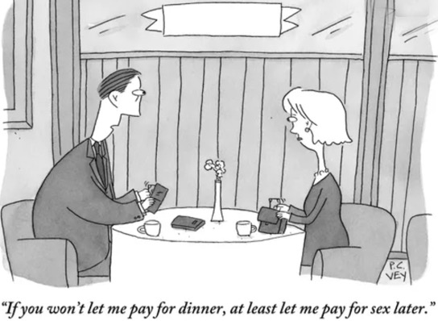
What Do Resellers Want?
They have concern for your welfare– a weak partner is a dangerous partner
  Financially
  Employee morale & retention
Motivated to put their needs high on your to-do list
Transparency – they don’t like surprises that can adversely impact their business
Want to avoid channel conflict
How they win:
  Selling tech & related services to a given market that is better than that of their competitors

Slide 44
Conclusion

Slide 45


There Is No One Right Answer
Every option has its own trade-offs – including doing nothing at all
Not all are even possible for every business
Things change: the same business financing option which works right now, may not later on
  Most businesses use or combine different options at different times
Largest determinants of what is right for you are why you want the money,
when, and how important it is to you
2 years later…

Slide 46



But…
For any particular situation, there are surely wrong ones. Choosing from among the right business financing option(s) is critical for your startup
  For example, if you do not want to sell your company, equity investment not right for you
  It’s got to be a good fit

Slide 47
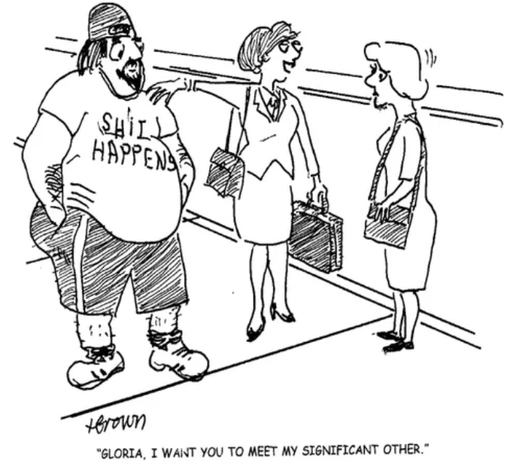
As In Life
The choice of the right partner(s) is at least as important as the method of financing

Slide 48

  These slides were prepared by women who enjoyed making them.
  No animals were harmed in the process.
  A little sense of humor never hurt anyone.

Slide 49
Important note: Chenope is creating this training series on business topics for miltech startups in Ukraine as part of a project with the Ministry of Digital Transformation of Ukraine. These materials are oriented specifically towards your unusual situation, as opposed to what one might find online generally about startups.
Our sole purpose with the Business Financing module is to make you aware of the opportunities and risks of different options that may be available to you as they exist in the West. Often this is quite different than what is true in Ukraine. Doing nothing is also an option, but it too has risks.
Chenope receives no compensation of any kind from any business financing entity. We ourselves are a 100%-employee owned startup, however we do use debt financing and have done deals with resellers of our technology. But what is right for us may not be right for you, and there are always tradeoffs in such decisions.

Slide 50


CHENOPE.COM
These slides were prepared for
50

